Slide 1
Chapter 2 Communication and Internet technologies
2.1 transmission and bit streaming

Slide 2
2.2 internet and WWW

Slide 3
Objectives
Describe what is meant by the World Wide Web (WWW) and the Internet
Explain how hardware is used to support the Internet: networks, routers, gateways, servers
Explain how communication systems are used to support the Internet: the public switched telephone network (PSTN), dedicated lines, cell phone network

Slide 4
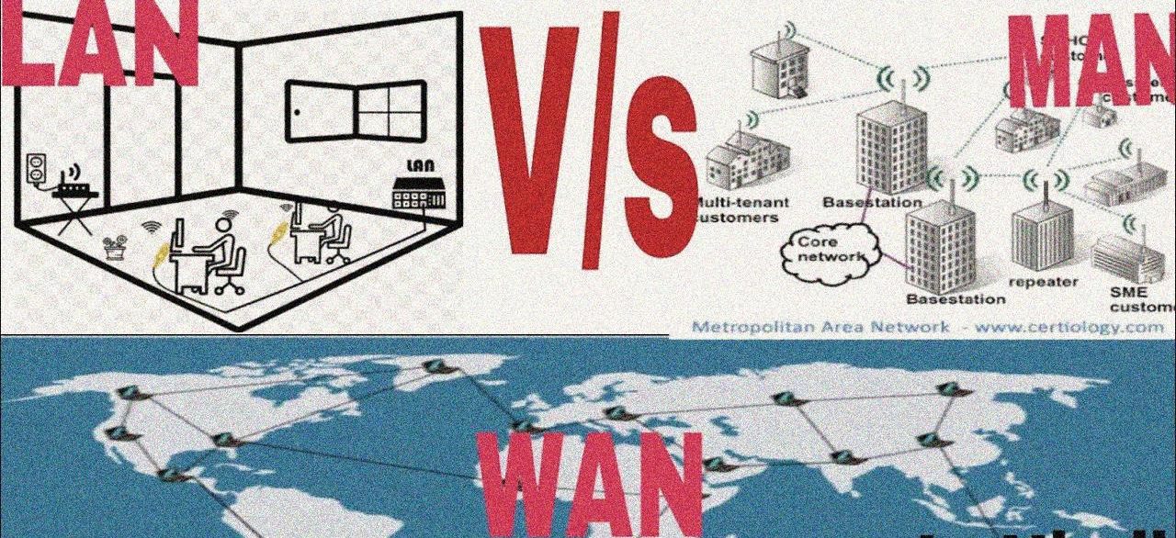
Network
How to connect computers together?
LAN (local area network) → MAN (metropolitan network) → WAN (wide area network)

Slide 5
Network
LAN (local area network)
LAN is restricted to small area such as office, home or college.
MAN (metropolitan network)
combine local networks usually confined within the city limits. The coverage of MAN can go up to 100 kilometers.
WAN (wide area network)
WAN is a broad network of interconnected devices within a large geographical area such as across province, cities or continents大洲(beyond 100km).
WAN
MAN
LAN

Slide 6
Internet
The Internet is the global system of interconnected computer networks that use the TCP/IP protocols suite (套件) to link devices worldwide.
TCP/IP (Transmission Control Protocol/Internet Protocol) refers to a set of protocols capable of transmitting information between a plurality of (多个) different networks. The TCP/IP protocol refers not only to TCP and IP, but to a set of protocols consisting of multiple protocols, just because the TCP and IP protocols are the most representative（具有代表性的） in the TCP/IP protocol, so they are called as the TCP/IP protocol.

Slide 7
Internet
True or False?
The Internet is the global system of interconnected computer networks that use the TCP protocol or IP protocol suite to link devices worldwide.

Slide 8
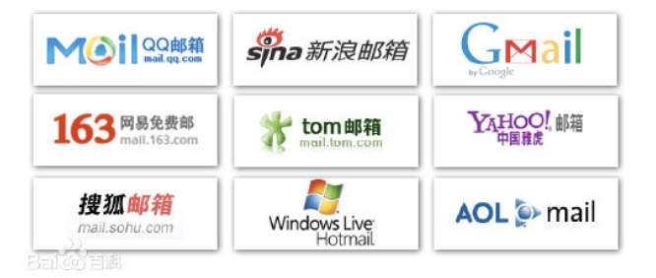
Internet
ISP (internet service provider)
Companies that provide the user with access to the Internet.
Such as Baidu, Gmail, Sina.

Slide 9
What do we need to connect computers together?
Some hardwares
A set of rules that determine how data is transmitted --> protocol

Slide 10
What do we need to connect computers together?
Some hardwares
Computers, printers, and telephones of users
Servers
Transmission media
A device that can forward data to the destination address --> Routers
A device that can connect to different types of networks --> Gateways
A set of rules that determine how data is transmitted --> protocol

Slide 11
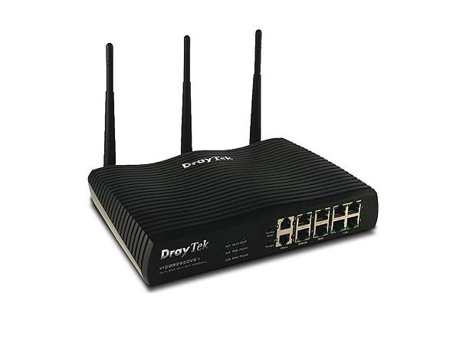
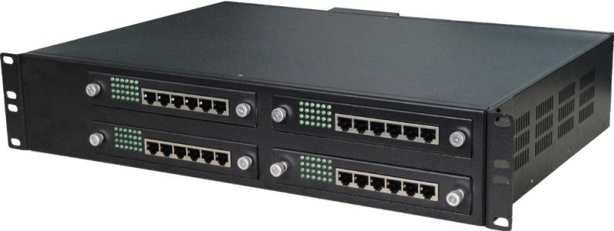
Internet-supporting hardware
Router
a networking device that forwards data packets between computer networks.
Gateway
a network node equipped for interfacing with another network that uses different communication protocols

Slide 12
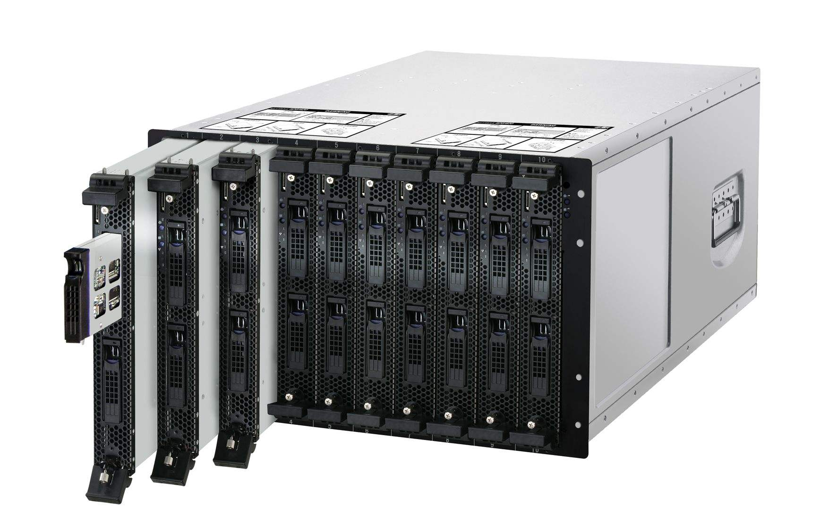
Internet-supporting hardware
Server
A device that provide services via a network.
An application server
A web server
A domain name server
A file server
A proxy server

Slide 13
Objectives
explain the benefits and drawbacks of using copper cable, fibre-optic cabling, radio waves, microwaves, satellites
show understanding of bit streaming (both real-time and on-demand)
show understanding of the importance of bit rates/broadband speed on bit streaming

Slide 14
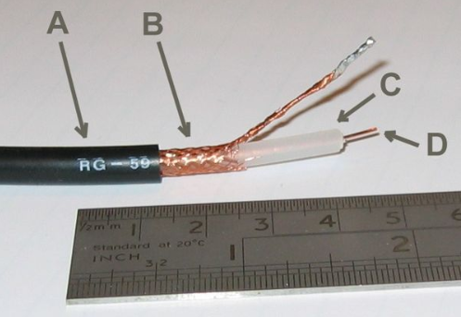
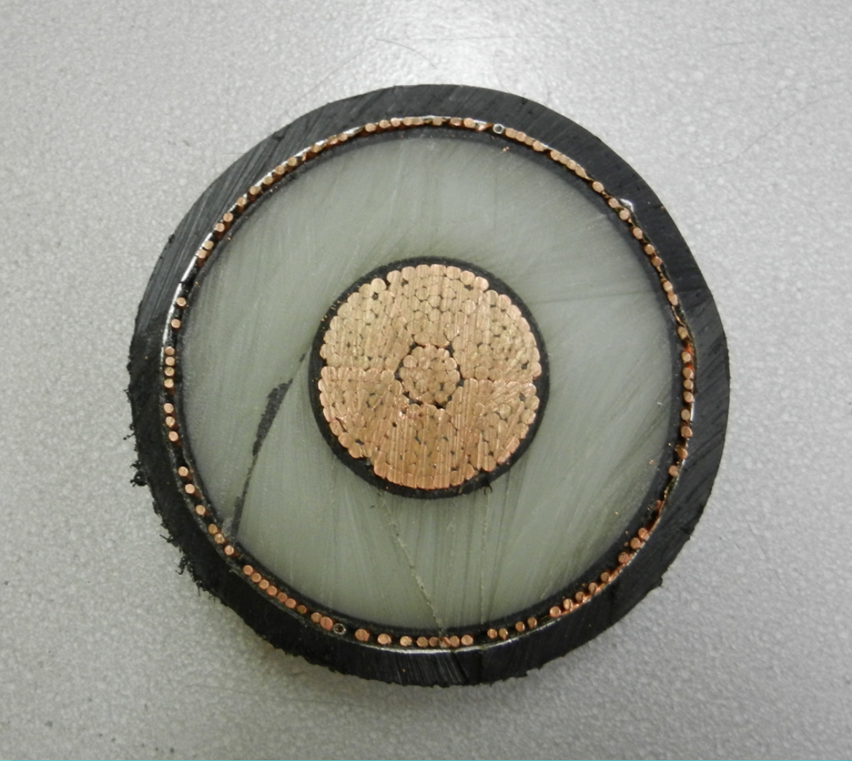
1. Transmission media
Coaxial cable: Faraday cage.

Slide 15
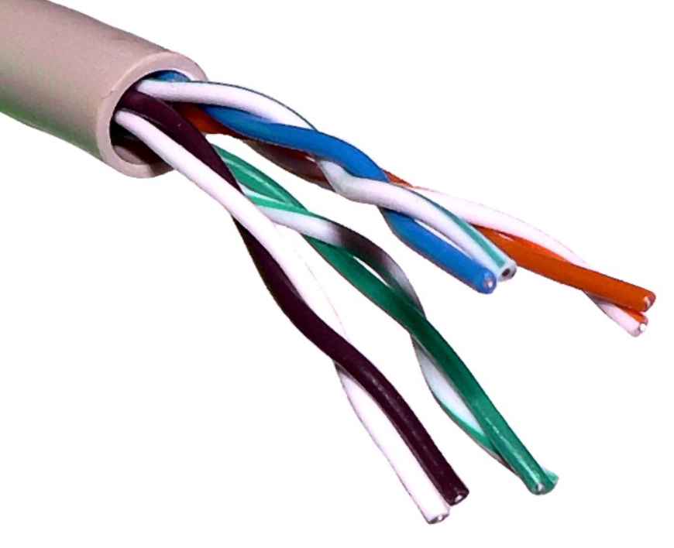
1. Transmission media
Twisted pair:

Slide 16
1. Transmission media
Twisted pair: The magnetic fields of the two wires are cancelled out, so that the magnetic interference of the pair of wires to the outside is as small as possible.
两根线的磁场被抵消，使得这一对电线对外界的电磁干扰尽可能小。

Slide 17
1. Transmission media
Fibre-optic cable has many advantages over copper wire:
Less interference in signal
Needs less signal boosting
More difficult to hack
Greater bandwidth

Slide 18
1. Transmission media
Fibre-optic cable also has some disadvantages over copper wire:
Hardware is more expensive
Electronics at both ends are more complex
Fibre-optic cables can break when bent

Slide 19
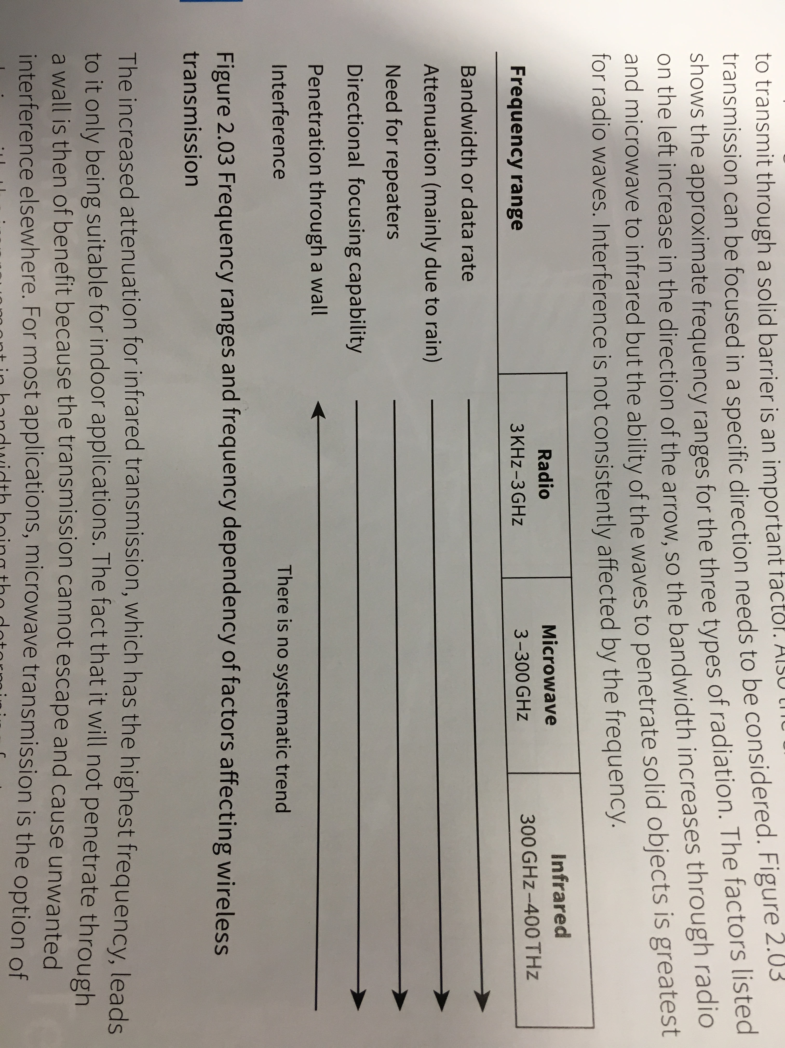
1. Transmission media
Wireless

Slide 20
Satellite communication
Artificial satellites orbiting the earth provide telecommunications between the satellite and receiving/ sending stations.
Applications are numerous and varied:
satellite radio and television broadcasting
photography of the earth
satellite-based Internet
satellite phones
military communications.
Advantage
Can connect with other components that are separated by greater distances
Disadvantage
Transmission delay

Slide 21
comparing cable and wireless transmission
Benefits of wireless networks compared to wired networks
Devices can be more mobile as they do not have to be connected to cable
Easier to set up, no cables need to be installed
Add additional devices is easier
Many different types of device can be connected at the same time

Slide 22
comparing cable and wireless transmission
Drawback of a wireless network compared to a wired network:
Easier to hack
Interference
Signal degrades (衰减) quickly

Slide 23
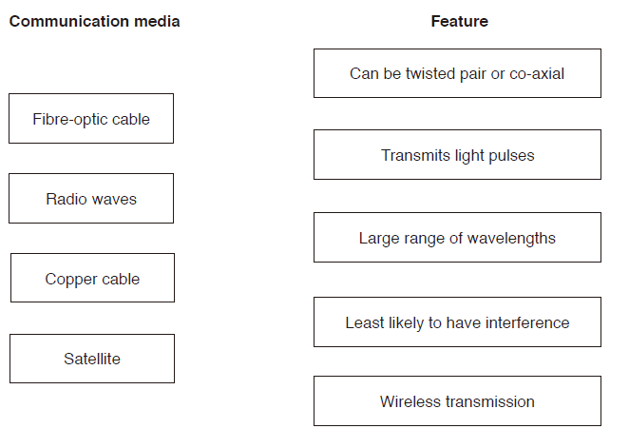
Excercise
Four communication media and five features are shown. Draw one or more lines from each communication media to the appropriate feature(s).

Slide 24
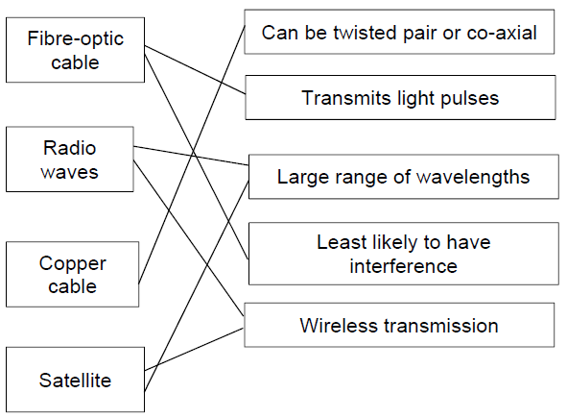
Excercise
Four communication media and five features are shown. Draw one or more lines from each communication media to the appropriate feature(s).

Slide 25
2. Bit streaming
Sequence of bits are transferred at a high speed over the internet.
Advantage
no need to wait for a whole file to be downloaded
no need to store large files on user’s computer
allows on demand playback
Disadvantage
video stops if very slow Internet speed
video stops if inadequate buffering capacity
loss of Internet means can’t access files
may require specific software to run the files
viruses can be downloaded from the websites

Slide 26
2. Bit streaming
Real-time
an event is captured live with a video camera, then the video camera is connected to a computer, the video signal is converted to streaming media files (encoded) on the computer and uploaded from the computer to a dedicated streaming server via cable, the server then sends the live images to all users requesting it as real-time video streaming and it cannot be paused暂停.
on-demand
digital files are converted to bit streaming format for broadcasting on the net, these encoded streaming video files are then stored on a server, a link for the encoded video is placed on a web site, a user clicks on the link to download the encoded streaming video, the streamed video is then broadcast to the user, it can be paused and re-watch or fast-forward.

Slide 27
World wide web (WWW)
The World Wide Web (WWW) is a system of many hypertexts that is accessible over the Internet.
Usually browsing the web is using the World Wide Web, while e-mail, ftp, and qq are not using the World Wide Web, but using the Internet.

Slide 28
World wide web (WWW)
Web pages are written in HTML
Web documents are accessed using browsers
URLs specify the location of the web pages
HTTP protocols are used to transmit data
Hypertext Markup Language (HTML)
The markup language for documents designed to be displayed in a web browser.
Browser
A program used to access the world wide web that displays web pages.
URL Uniform resource locator
A URL is the address of a resource on the Internet, like a house number on a network. A typical URL could have the form http://www.example.com/index.html, which indicates a protocol (http), a hostname (www.example.com), and a file name (index.html).
HTTP Hypertext transfer protocol
A set of rules for transferring files on the web.

Slide 29
Excersise
Distinguish between the Internet and the World Wide Web (WWW).

Slide 30
PSTN (public switched telephone network, 公共交换电话网 )
PSTN is a circuit-switched network for global voice communications. It is the largest network in the world and has about 8 billion users.

Slide 31
PSTN (public switched telephone network, 公共交换电话网 )
What do the initials PSTN stand for?

Slide 32
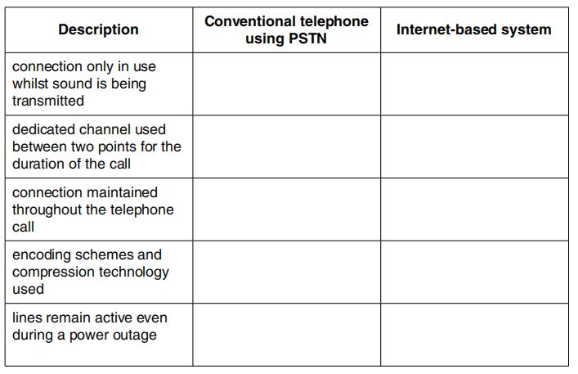
PSTN (public switched telephone network, 公共交换电话网 )
Telephone calls can be made by using:
conventional telephones (using the Public Service Telephone Network (PSTN) system) over a wired network
a computer, equipped with speakers and microphone, connected to the Internet
Put a tick (√) in the correct column to match each description to the appropriate communication method.

Slide 33
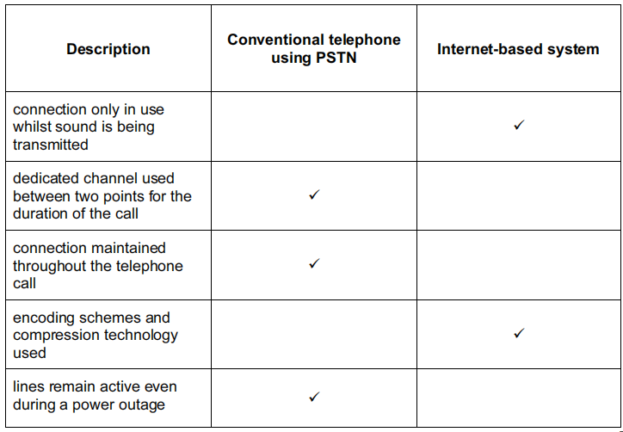
PSTN (public switched telephone network, 公共交换电话网 )
Telephone calls can be made by using:
conventional telephones (using the Public Service Telephone Network (PSTN) system) over a wired network
a computer, equipped with speakers and microphone, connected to the Internet
Put a tick (√) in the correct column to match each description to the appropriate communication method.

Slide 34
Dedicated line(专线)
Government agencies机构 or some enterprises, for reasons of security, transmission rate and other factors, will use a dedicated transmission line, which is called a dedicated line
Unlike PSTN and normal Internet connections, leased lines are not public.

Slide 35
Dedicated line(专线)
A business is based on a number of UK sites. List advantages to the company of using dedicated lines for all its digital communications.

Slide 36
Cell phone networks
After the signal coverage area is partitioned分割的, the two non-adjacent areas can communicate with the same frequency, thereby achieving frequency reuse.

Slide 37
2.3 client-server architecture

Slide 38
Objective
explain the client-server model of networked computers
give examples of applications which use the client-server model

Slide 39
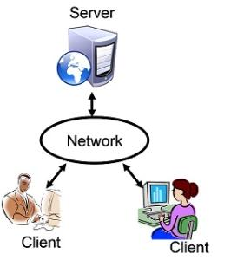
Client-server

Slide 40
Client-server application
How can we browse a web page by using the C-S model
1. the user opens up a browser on the client computer
2. the user types键入 in the URL of the web application
3. the browser asks the DNS（Domain Name System） for the IP address
4. The browser connects to the IP address and sends a request for the web page
5. the page is sent by the server to the browser
6. the browser displays the page

Slide 41
2.4 IP addressing

Slide 42
Objective
explain the format of an IP address and how an IP address is associated with a device on a network
explain the difference between a public IP address and a private IP address and the implication for security
explain how a Uniform Resource Locator (URL) is used to locate a resource on the World Wide Web (WWW) and the role of the Domain Name Service

Slide 43
What do we need to connect computers together?
Some hardwares
A set of rules that determine how data is transmitted --> protocol

Slide 44
IP，IP Address
The Internet Protocol (IP) is the principal communications protocol in the Internet protocol suite for relaying datagrams across network boundaries. Its routing function enables internetworking, and essentially establishes the Internet. Internet协议(IP)是Internet协议套件中用于跨网络边界中继数据报的主要通信协议。它的路由功能实现了互连，并从本质上建立了Internet。
An Internet Protocol address (IP address) is a numerical label标签 assigned to each device connected to a computer network that uses the Internet Protocol for communication.

Slide 45
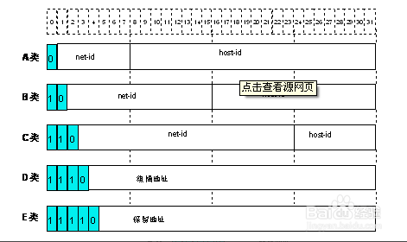
IPv4 addressing
It is based on 32 bits (4 bytes), hierarchical(分层的) address of a device on the internet

Slide 46
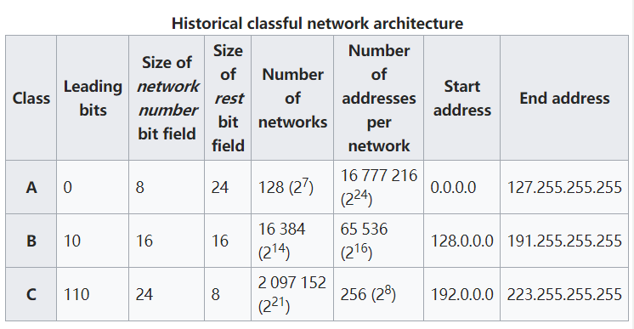
IPv4 addressing
It is based on 32 bits (4 bytes), hierarchical address of a device on the internet

Slide 47
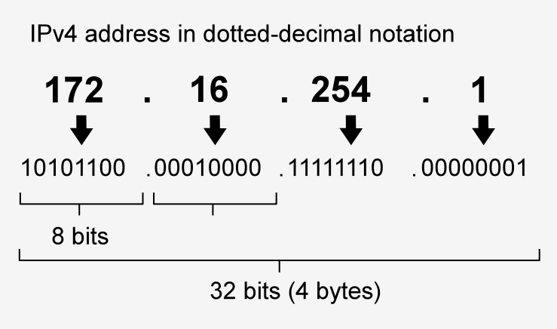
IPv4 addressing
It is based on 32 bits (4 bytes), hierarchical address of a device on the internet

Slide 48
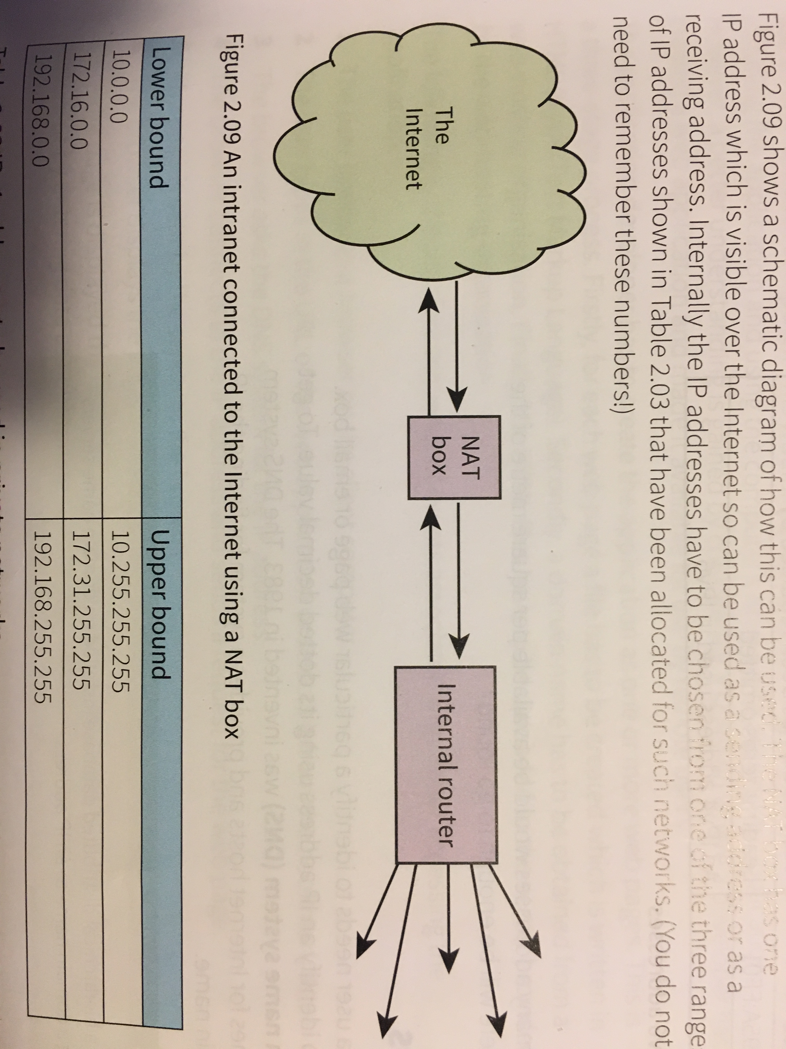
Network address translation (NAT)
Private IP address can be simultaneously used by any number of different private networks

Slide 49
Public address & private address
Public address can be reached across the Internet.
A private address is more secure than a public address
Public addresses are provided by ISP // Private addresses are assigned by the router (of the network concerned).
Public addresses are unique (to the Internet) // Private addresses (are unique within their network, but) can be duplicated within other (discrete) networks.
10.0.0.1 to 10.255.255.254 and 172.16.0.1 to 172.31.255.254 and 192.168.0.1 to 192.168.255.254 form the private address space // IP addresses from the private address space are never assigned as public.
NAT (Network Address Translation) is necessary for a private IP address to access the Internet directly.

Slide 50
IPv6 addressing
8 parts with each of these represented by 4 hexadecimal characters.
128 bit addressing allowing 2¹²⁸ different addressing
68E6:7C48:FFFE:FFFF:3D20:1180:695A:FF01

Slide 51
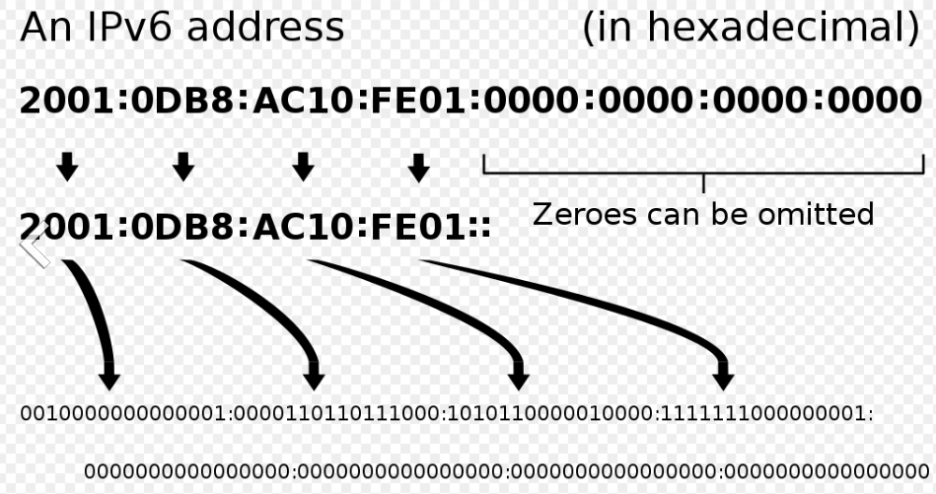
IPv6 addressing

Slide 52
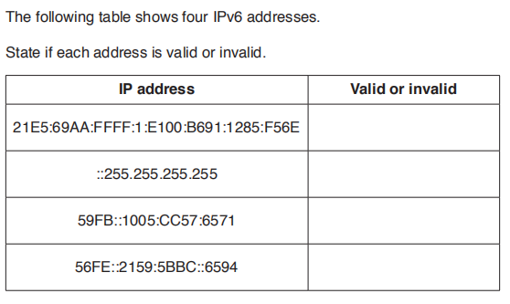

Slide 53
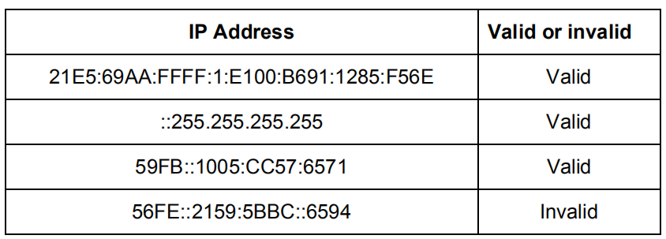

Slide 54
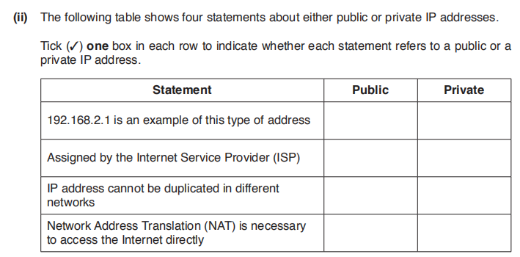

Slide 55
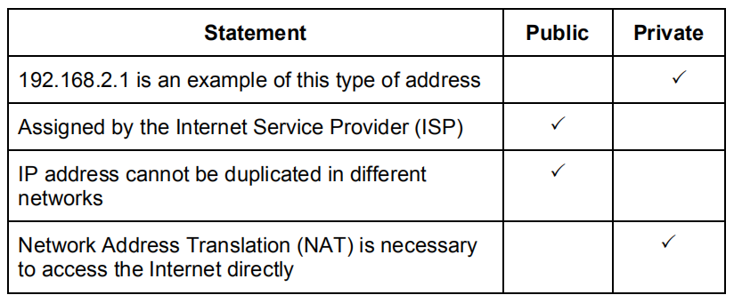

Slide 56
Domain names system
A distributed database that maps domain names and IP addresses to each other.
Name resolution
Looking up a domain name to find an IP address
Naming system is hierarchical, there are more than 250 top-level domains (.com,.edu,.gov)
命名系统是分级的，共有250多个顶级域名

Slide 57
HTML
<html>
<head>
…
</head>
<body>
…
</body>
</html>

Slide 58
JavaScript
<script>
… // lines of JavaScript code
</script>
Prompt
Provide text to guide the user as to what should be input
Alert
Display an explanatory text with the output value
Data validation and verification can be handled using JavaScripte

Slide 59
PHP
<?php>
… // lines of PHP code
<?>
$_GET
Getting the parameter value, can be recognized as not being a variable
It is imperative that database remains on the server and only the results of queries are displayed on a browser screen

